Slide 1
Introduction to SPSS

Slide 2


Objectives
At the end of this session participants should be able to:
Enter data in SPSS
Summarize data in tables and graphs
Perform analysis in SPSS

Slide 3
Introduction: What is SPSS?
Originally it is an acronym of Statistical Package for the Social Science but now it stands for Statistical Product and Service Solutions
One of the most popular statistical packages which can perform highly complex data manipulation and analysis with simple instructions

Slide 4
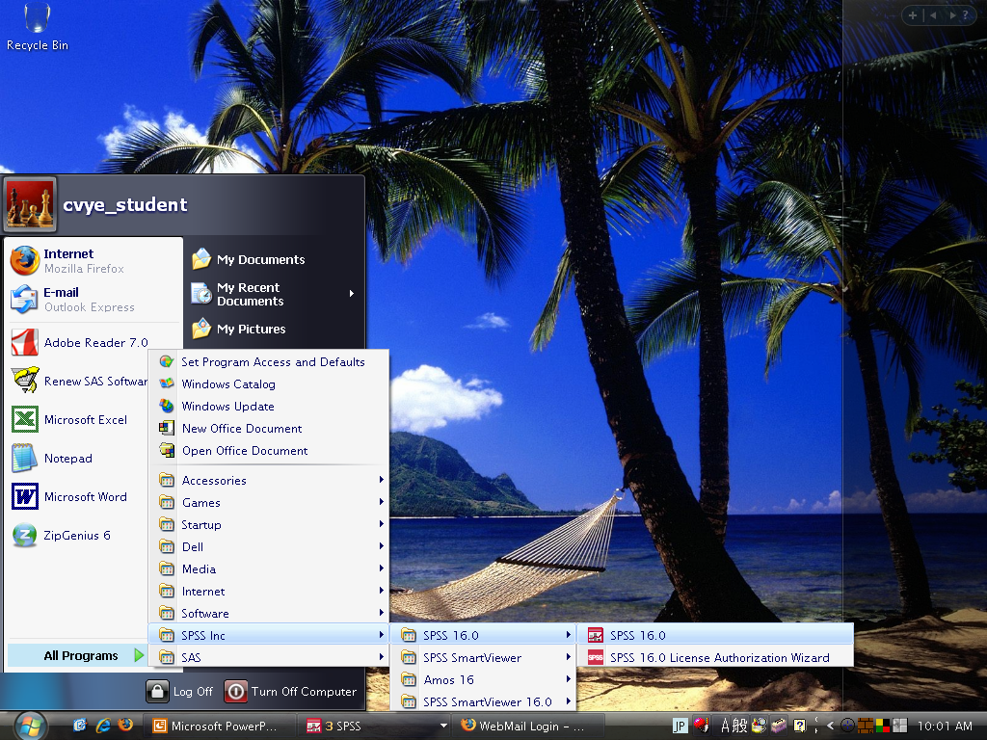
Opening SPSS
Start → All Programs → SPSS Inc→ SPSS 20.0 →
SPSS 20.0

Slide 5
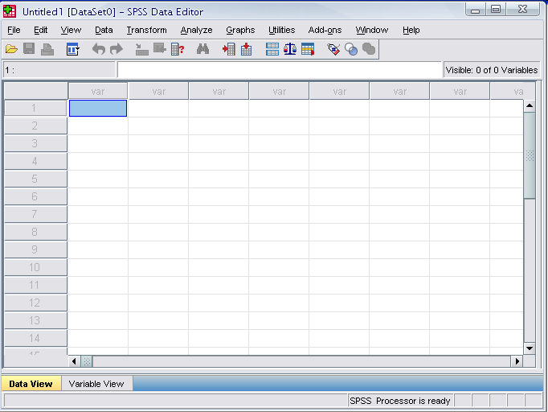
Opening SPSS
The default window will have the data editor
There are two sheets in the window:
1. Data view 2. Variable view

Slide 6
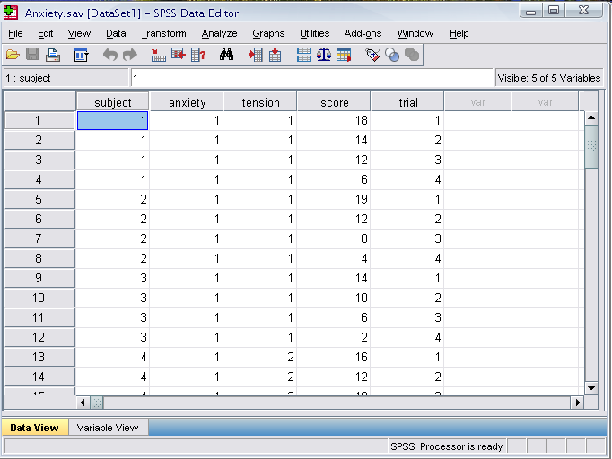
Data Editor
Data Editor
Spreadsheet-like system for defining, entering, editing, and displaying data. Extension of the saved file will be “sav.”

Slide 7
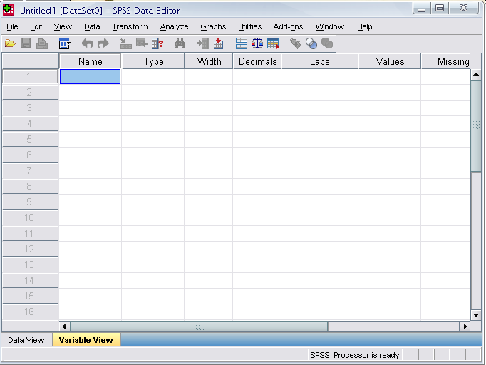
Data View window
The Data View window
This sheet is visible when you first open the Data Editor and this sheet contains the data
Click on the tab labeled Variable View
Click
Notes:
This window shows the actual data values and the name of the variables.

Slide 8
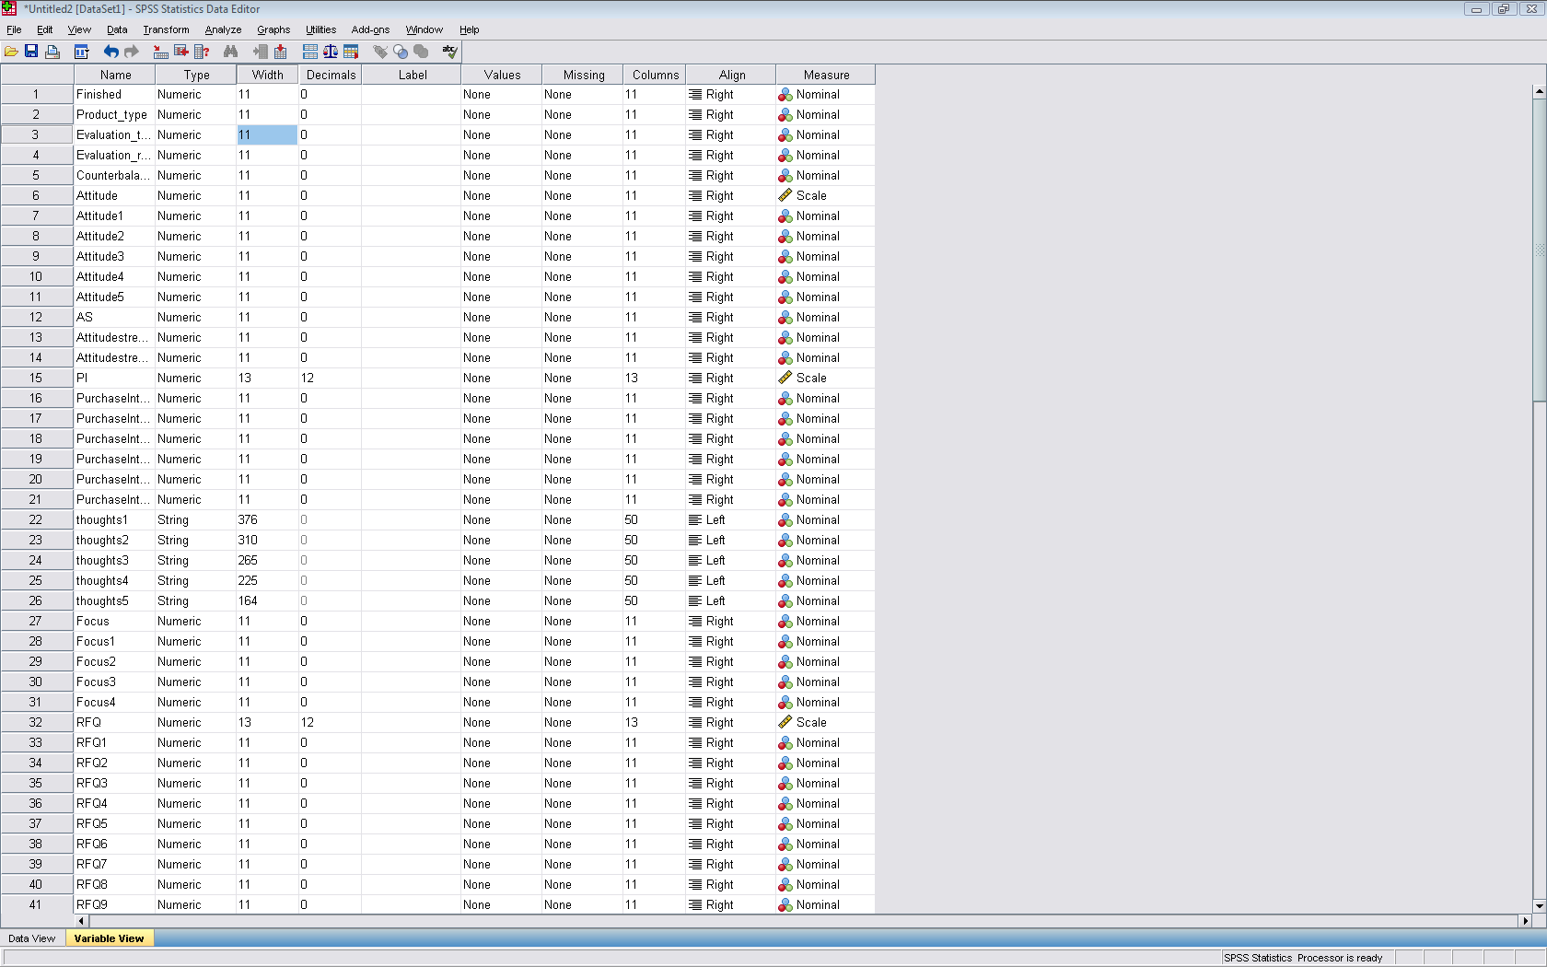

Slide 9
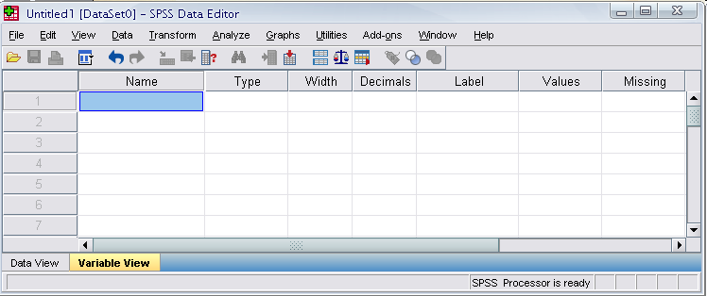
Variable View window
This sheet contains information about the data set that is stored with the dataset.
Name
The first character of the variable name must be alphabetic
Variable names must be unique, and have to be less than 64 characters.
Spaces are NOT allowed.

Slide 10
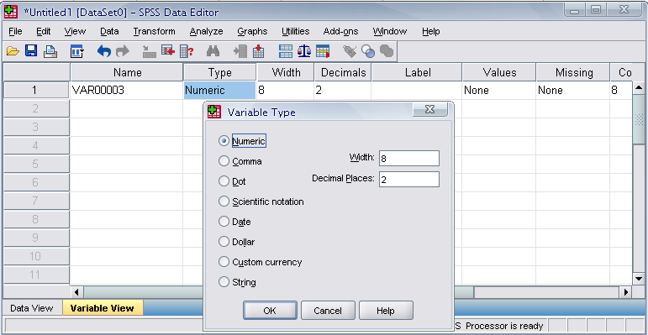
Variable View window: Type
Type
Click on the ‘type’ box. The two basic types of variables that you will use are numeric and string. This column enables you to specify the type of variable.

Slide 11
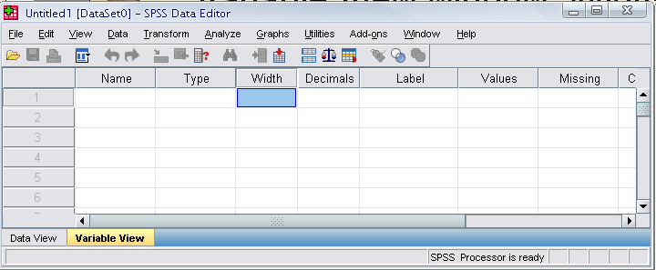
Variable View window: Width
Width
Width allows you to determine the number of characters SPSS will allow to be entered for the variable

Slide 12
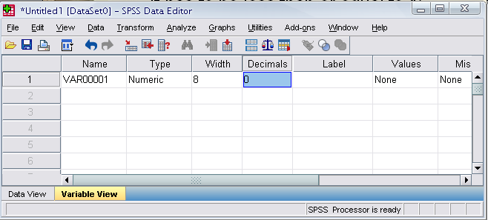
Variable View window: Decimals
Decimals
Number of decimals
It has to be less than or equal to 16

Slide 13
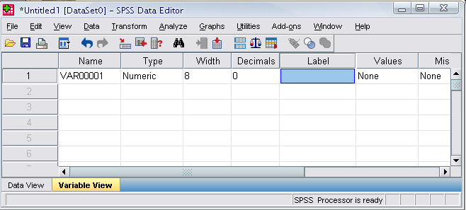
Variable View window: Label
Label
You can specify the details of the variable
You can write characters with spaces up to 256 characters

Slide 14
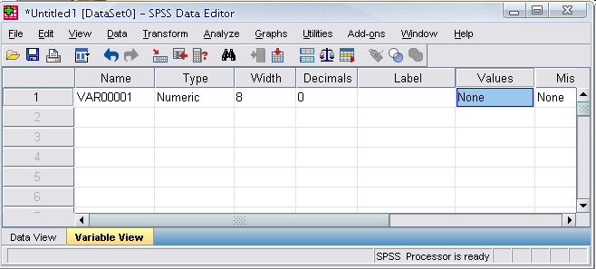
Variable View window: Values
Values
This is used and to suggest which numbers represent which categories when the variable represents a category

Slide 15
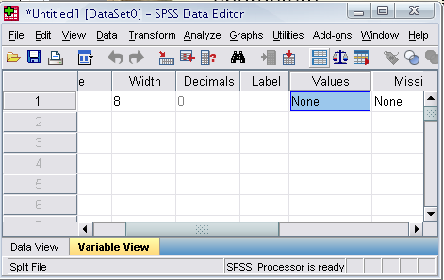
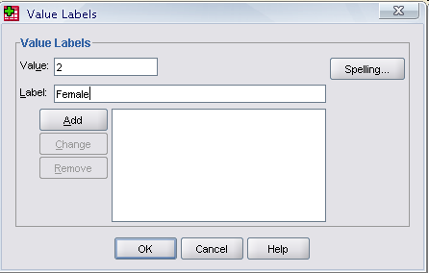
Defining the value labels
Click the cell in the values column as shown below
For the value, and the label, you can put up to 60 characters.
After defining the values click add and then click OK.
Click

Slide 16
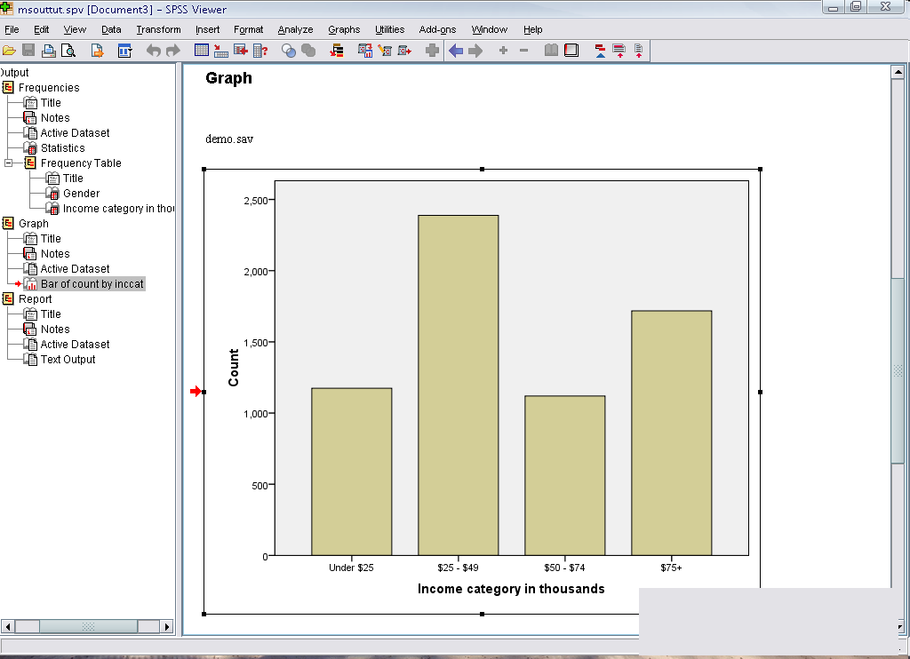
Output Viewer
Output Viewer
Displays output and errors. Extension of the saved file will be “spv.”
Notes:
The graph shows that more people who receives wireless service tends to own PDA compared to people who doesn’t receive wireless service.

Slide 17
Practice 1
How would you put the following information into SPSS?
name | gender | height
sheryl | female | 5.7
jennifer | female | 5.4
tara | female | 5.3
christian | male | 5.6
jose | male | 5.8
roberto | male | 5.7
kasie | female | 5.5
cady | female | 5.5
sandy | female | 5.6
daniel | male | 6.0
kurra | female | 5.4
ashley | female | 5.4
alain | male | 6.1

Slide 18
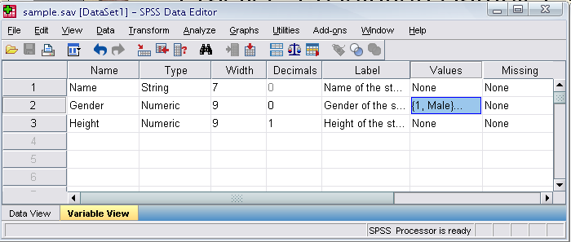
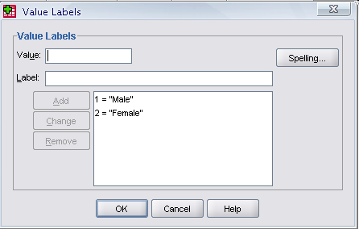
Practice 1 (Solution Sample)
Click

Slide 19
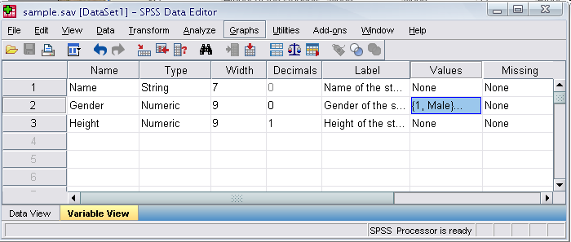
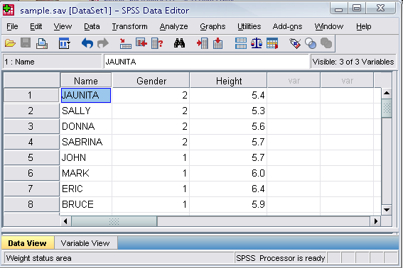
Click

Slide 20
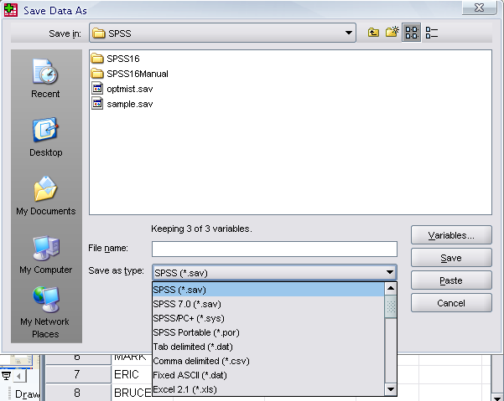
Saving the data
To save the data file you created simply click ‘file’ and click ‘save as.’ You can save the file in different forms by clicking “Save as type.”
Click

Slide 21
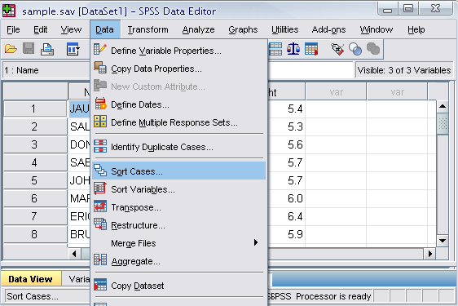
Sorting the data
Click ‘Data’ and then click Sort Cases

Slide 22
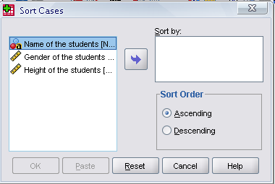
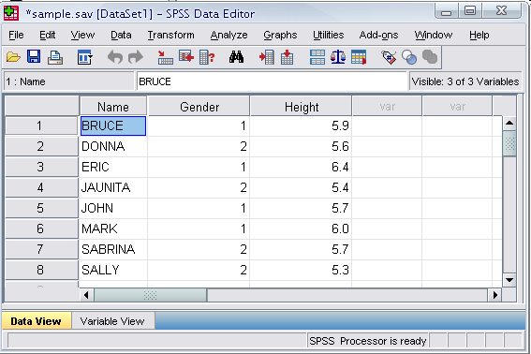
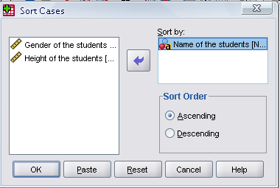
Sorting the data (cont’d)
Double Click ‘Name of the students.’ Then click ok.
Click
Click

Slide 23

Practice 2
How would you sort the data by the ‘Cholesterol level’ of the subjects in descending order? (From data sheet for SPSS)
Calculate Descriptive statistics for cholesterol
Click data, sort cases, double click ‘cholesterol,’ click ‘descending,’ and finally click ok.

Slide 24
The basic analysis

Slide 25
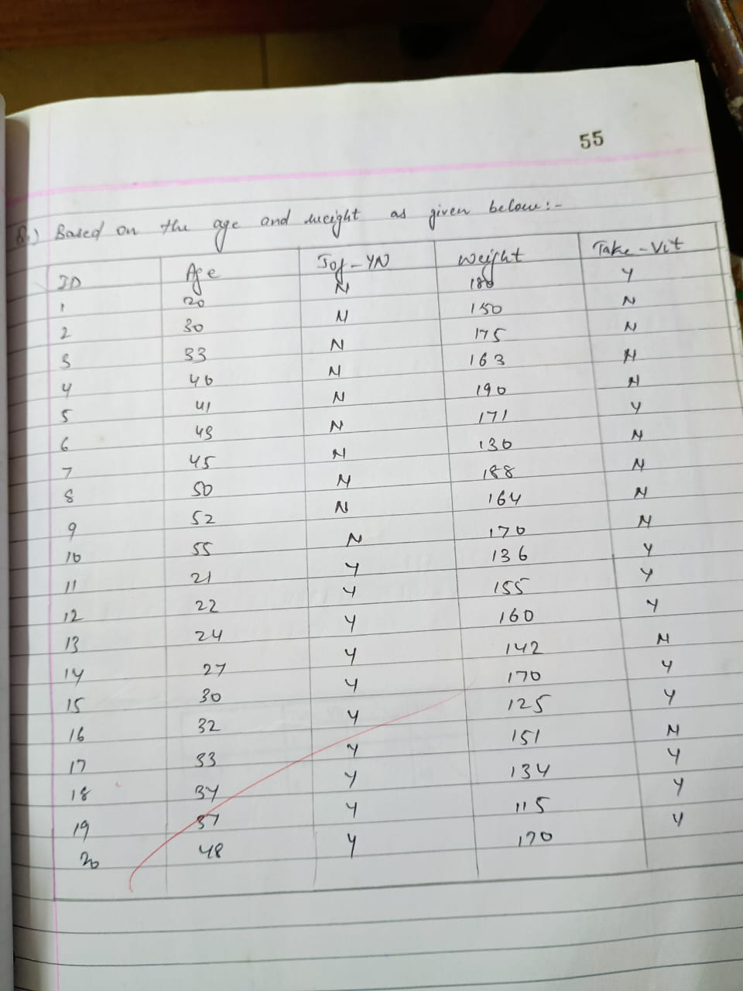

Slide 26
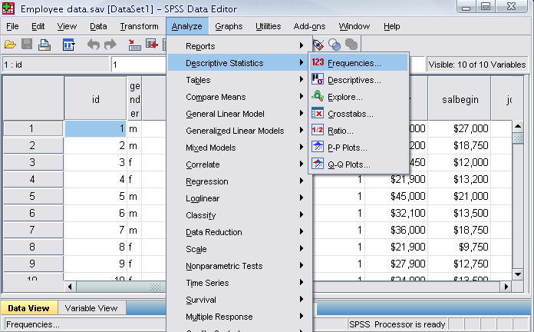
Frequencies
Click ‘Analyze,’ ‘Descriptive statistics,’ then click ‘Frequencies’

Slide 27
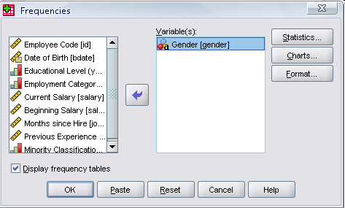
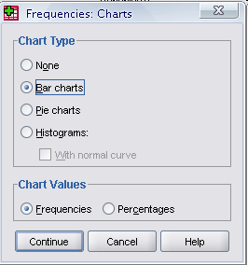
Frequencies
Click Jogging and put it into the variable box.
Click ‘Charts.’
Then click ‘Bar charts’ and click ‘Continue.’
Click
Click

Slide 28
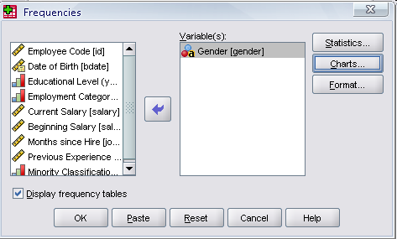
Frequencies
Finally Click OK in the Frequencies box.
Click

Slide 29
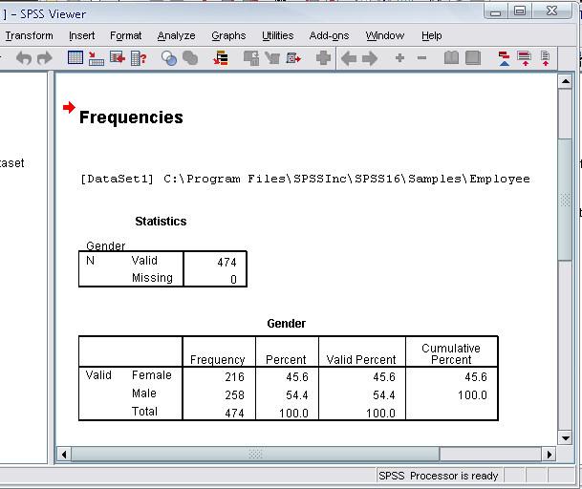
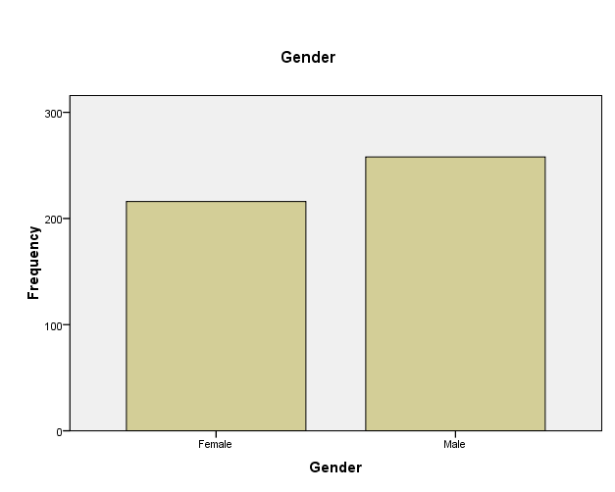

Slide 30
Practice 3
Do a frequency analysis on the variables “Taking Vitamins” (from data entry sheet in your folder)
Create pie charts for it

Slide 31
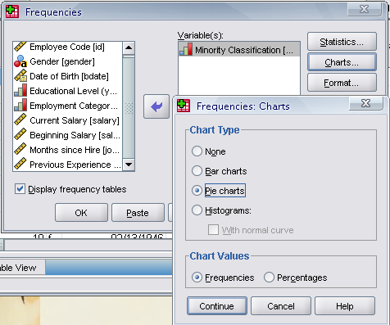
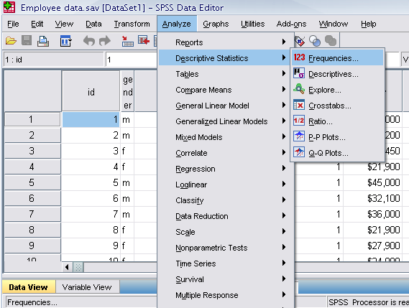

Slide 32
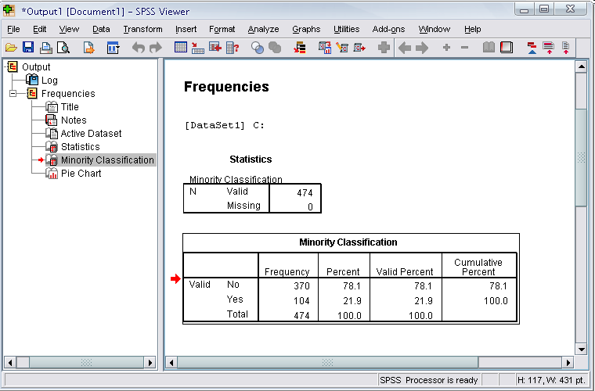
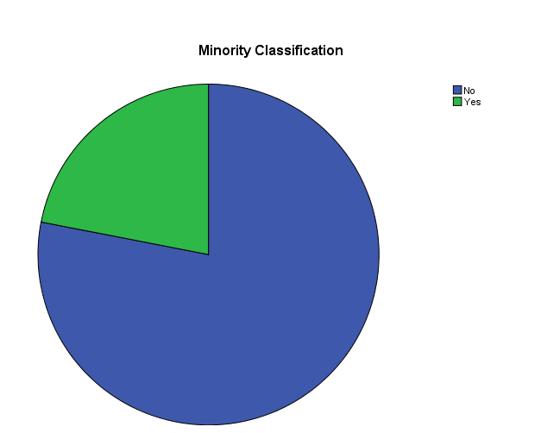
Answer
Click

Slide 33
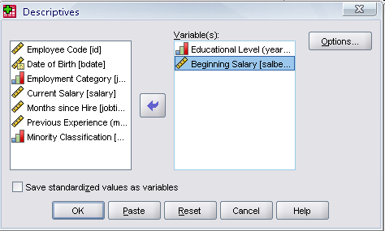
Descriptives
Click ‘Analyze,’ ‘Descriptive statistics,’ then click ‘Descriptives…’
Click ‘Educational level’ and ‘Beginning Salary,’ and put it into the variable box.
Click Options
Click

Slide 34
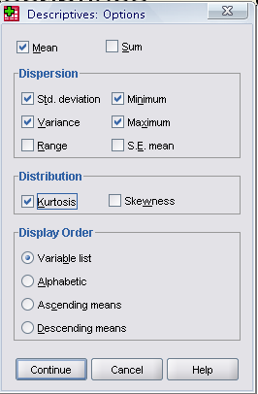
Descriptives
The options allows you to analyze other descriptive statistics besides the mean and Std.
Click ‘variance’ and ‘kurtosis’
Finally click ‘Continue’
Click
Click

Slide 35
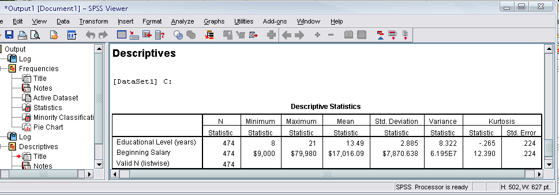
Descriptives
Finally Click OK in the Descriptives box. You will be able to see the result of the analysis.

Slide 36
Helpful Resources
There are many resources online to help you learn SPSS
(tutorials, blogs, etc.). Here are a few examples:
http://www.stat.tamu.edu/spss.php
http://www.ats.ucla.edu/stat/SPSS/
http://www.lrz.de/~wlm/wlmspss.htm
.

Slide 37
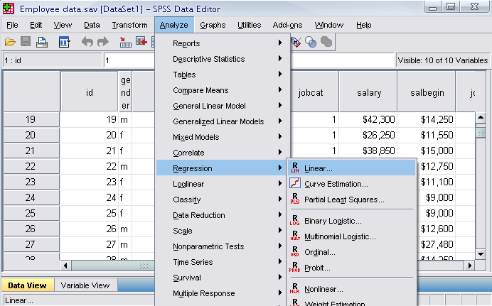
Regression Analysis
Click ‘Analyze,’ ‘Regression,’ then click ‘Linear’ from the main menu.

Slide 38
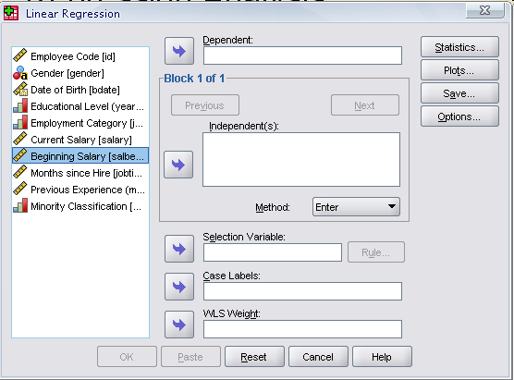
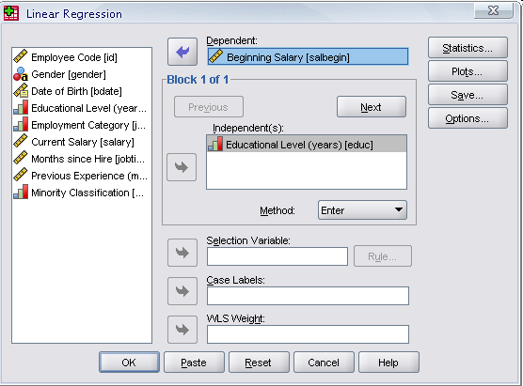
Regression Analysis
For example let’s analyze the model
Put ‘Beginning Salary’ as Dependent and ‘Educational Level’ as Independent.
Click
Click

Slide 39
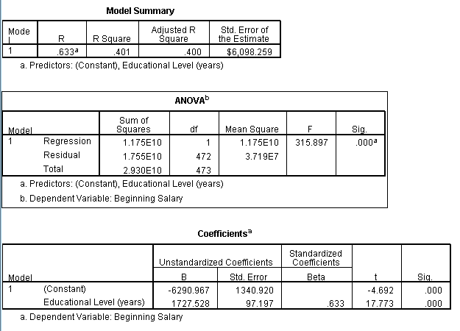
Regression Analysis
Clicking OK gives the result

Slide 40
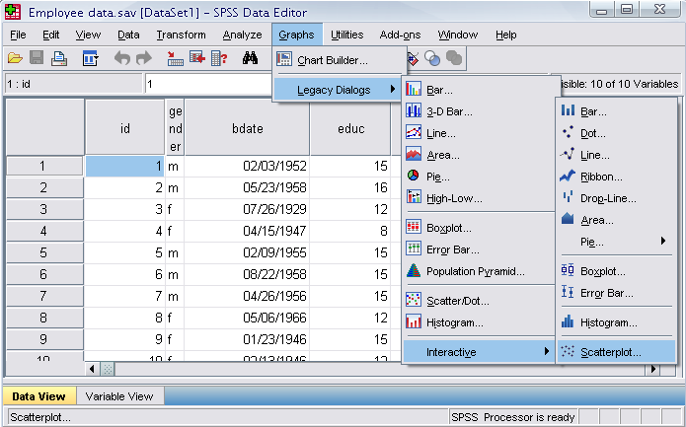
Plotting the regression line
Click ‘Graphs,’ ‘Legacy Dialogs,’ ‘Interactive,’ and ‘Scatterplot’ from the main menu.

Slide 41
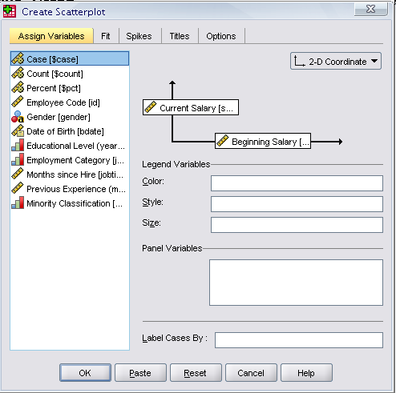
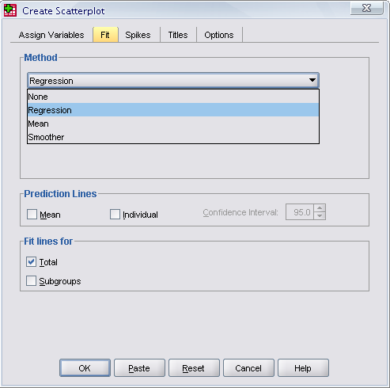
Plotting the regression line
Drag ‘Current Salary’ into the vertical axis box and ‘Beginning Salary’ in the horizontal axis box.
Click ‘Fit’ bar. Make sure the Method is regression in the Fit box. Then click ‘OK’.
Set this to Regression!
Click

Slide 42
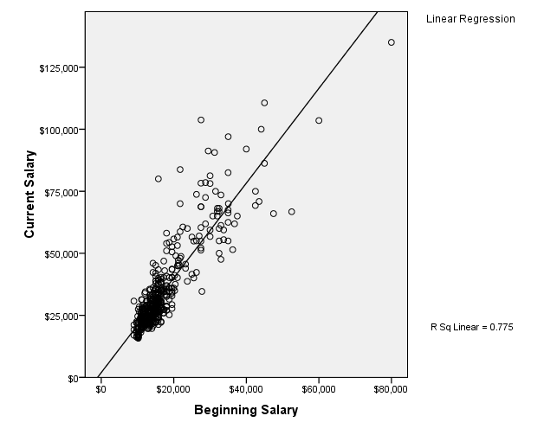

Slide 43
Scatter Plot with best fit line between SEQ and MCQ marks

Slide 44
Practice 5
Find out whether or not the previous experience of workers has any affect on their beginning salary?
Take the variable “salbegin,” and “prevexp” as dependent and independent variables respectively.
Plot the regression line for the above analysis using the “scatter plot” menu.

Slide 45
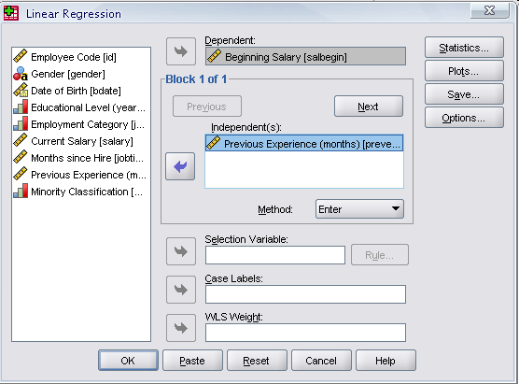
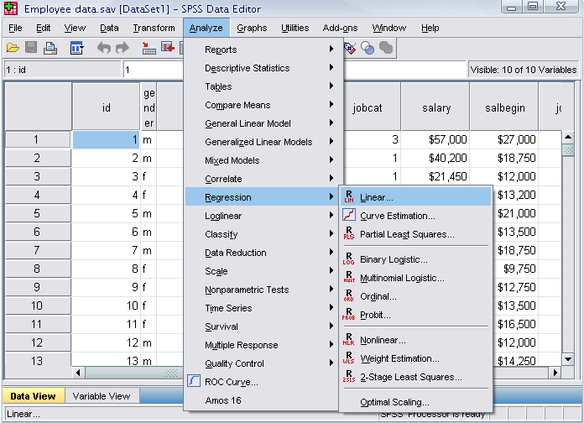
Answer
Click

Slide 46
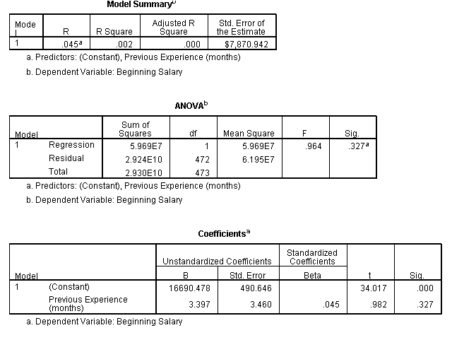

Slide 47
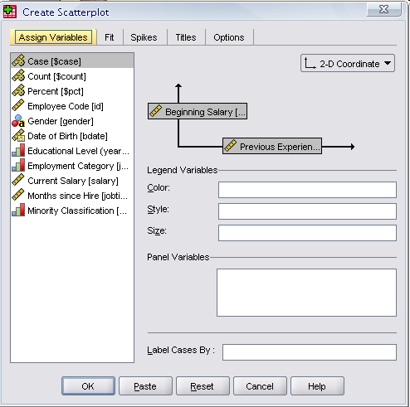
Click on the “fit” tab to make sure the method is regression

Slide 48
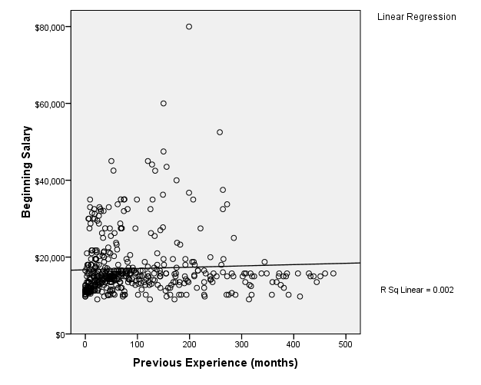

Slide 49
THANK YOU

